Slide 1


ARCH & GARCH
Muhammad Akmal Farouqi
15/5/2024
www.ugm.ac.id
Locally Rooted, Globally Respected
Notes:
https://stats.stackexchange.com/questions/24072/interpreting-rs-ur-df-dickey-fuller-unit-root-test-results

Slide 2

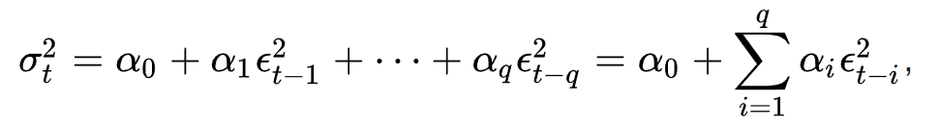
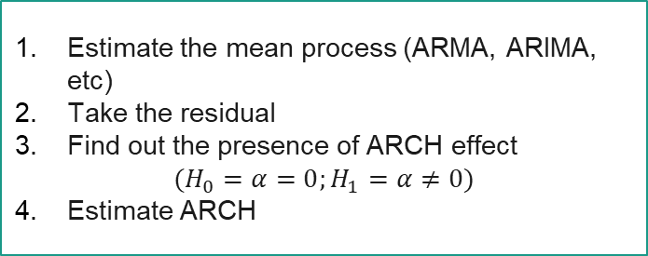
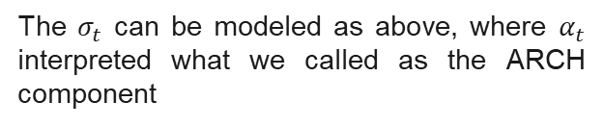
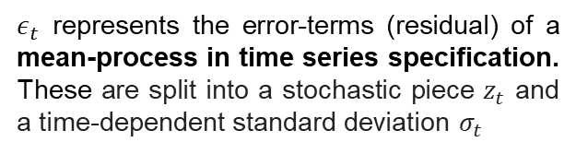
Auto Regressive Conditional Heteroskedasticity (ARCH)
Conditional Heteroskedasticity is a term referencing a condition where variances of a variable are changed based on past information
Hence, in order to estimate the variance using ARCH, we have to:
$ε_{t}$ represents the error-terms (residual) of a mean-process in time series specification. These are split into a stochastic piece $z_{t}$ and a time-dependent standard deviation $σ_{t}$
Estimate the mean process (ARMA, ARIMA, etc)
Take the residual
Find out the presence of ARCH effect
$$(H_{0}=α=0;H_{1}=α≠0)$$
Estimate ARCH
The $σ_{t}$ can be modeled as above, where $α_{t}$ interpreted what we called as the ARCH component

Slide 3
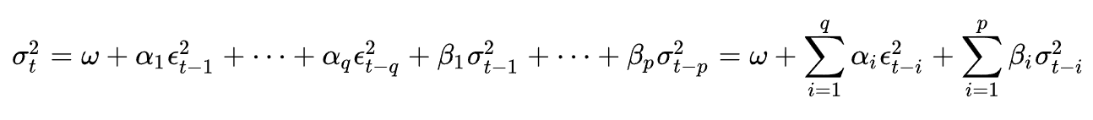

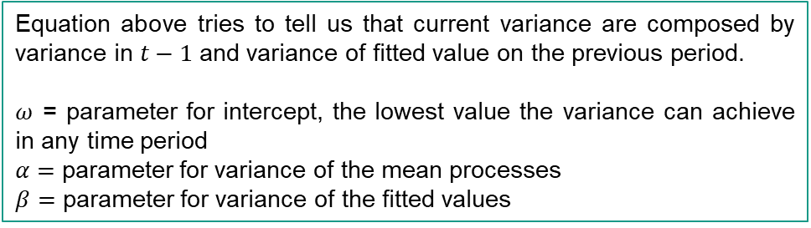
Generalized Auto Regressive Conditional Heteroskedasticity (GARCH)
GARCH model acknowledges another factor affecting variance, which is the variance (error term) of an ARCH model
Equation above tries to tell us that current variance are composed by variance in $t−1$ and variance of fitted value on the previous period.
$ω$ = parameter for intercept, the lowest value the variance can achieve in any time period
$α=$ parameter for variance of the mean processes
$β=$ parameter for variance of the fitted values

Slide 4
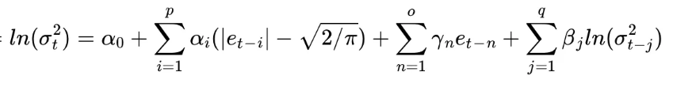
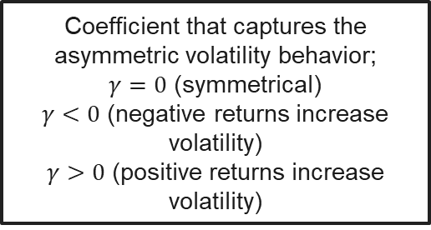
Exponential GARCH (EGARCH)
EGARCH is a development of GARCH model that works well in the presence of exponential volatility and asymmetric effects
Coefficient that captures the asymmetric volatility behavior;
$γ=0$ (symmetrical)
$γ<0$ (negative returns increase volatility)
$γ>0$ (positive returns increase volatility)
Modified ARCH term that captures standardized log returns

Slide 5
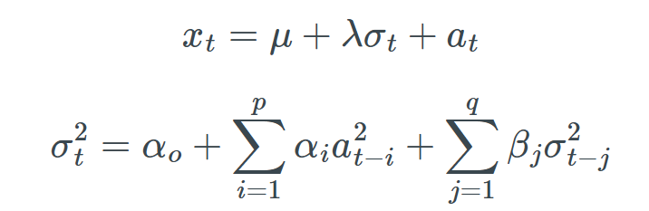

GARCH-in-Mean (GARCH-M)
The GARCH-in-mean (GARCH-M) model adds a heteroskedasticity term into the mean equation. Useful for a data where the mean is depends on its volatility
$λ$ = volatility coefficient for the mean

Slide 6
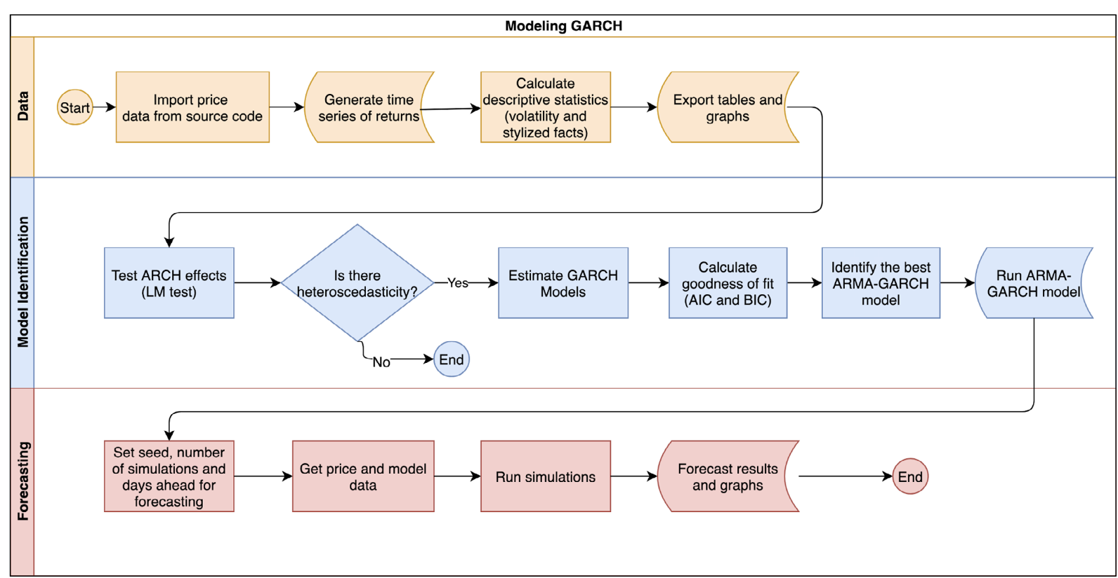
Generalized Auto Regressive Conditional Heteroskedasticity (GARCH)
Notes:
https://www.redalyc.org/journal/840/84064925005/html/

Slide 7
Thank You

